Slide 1

Windows Server 2022

Slide 2




Windows Server Anywhere
  Azure
  Best cloud for
  Windows Server
  Hybrid
  Extend to Azure with Azure Arc
  On-premises
  Upgrade to 2022
In the cloud | In your datacenter | At the edge

Slide 3







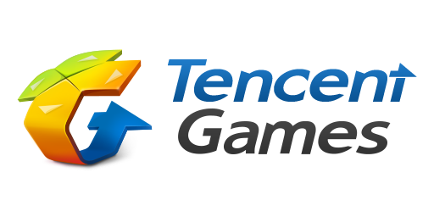










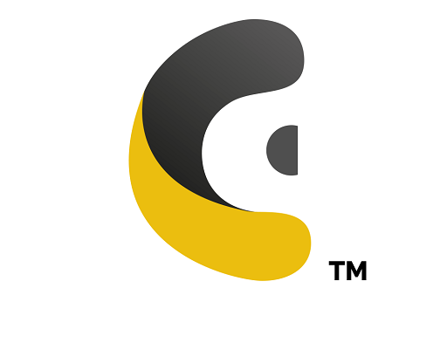

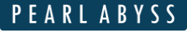


Windows Server customers
CadDo

Slide 4
Windows Server
Over 25 years of innovation
Windows
Server 2022
Windows
Server NT4
Windows
Server 2000
Windows
Server 2003
Windows
Server 2008
Windows
Server 2012
Windows
Server 2016
Windows
Server 2019
In the cloud | In your datacenter | At the edge

Slide 5
Introducing Windows Server 2022 (in preview)
Run business critical workloads in Azure, on-premises and at the edge
Advanced multi-layered security
Hybrid capabilities with Azure
Flexible application platform
Elevate the security posture of your organization starting with the operating system
Extend your datacenter to Azure
for greater IT efficiency
Empower developers and IT pros with an application platform to build and deploy diverse applications

Slide 6
Security threats are constant and costly
February 2020
142,000,000
Hotel guests’ data
compromised
July 2020
450,000
Residents of Polk County,
Florida’s tax collector
compromised
April 2020
112,000
Employees and patients personal
and medical info compromised
$3.62M
Average total cost of a data breach
Notes:
<Do we have a standard security slide we can use>
The average cost of a data breach is $3.62 million dollars.
MGM Resorts
February 20, 2020: Over 10.6 million hotel guests who have stayed at the MGM Resorts have had their personal information posted on a hacking forum. The data dump exposed includes names, home addresses, phone numbers, emails, and dates of birth of former hotel guests. Updated July, 15 2020: Researchers found 142 million personal records from former guests at the MGM Resorts hotels for sale on the Dark Web, hinting that the original breach was larger than previously announced.
Beaumont Health
April 20, 2020: The personal and medical information of over 112,000 employees and patients of Beaumont Health was accessed by a malicious actor after compromising employee email accounts through a phishing attack. The information impacted includes names, birth dates, Social Security numbers, driver’s license numbers, medical condition data, and bank account data.
Polk County
July 16, 2020: Over 450,000 residents of Polk County, Florida had their driver’s license numbers and Social Security numbers exposed after an employee at Polk County Tax Collector fell victim to a phishing attack.

Slide 7
We need better security solutions
“How do we stay
ahead of emerging security exploits?”
“How do I
keep virtualized workloads safe?”
IT
$141*
Average amount paid
in USD for each lost
or stolen record containing sensitive or
confidential information
$3.62million*
Average total cost
of a data breach
*Cost of data breach study: Global analysis, 2017, Ponemon Institute
Notes:
Security continues to be a top priority for our customers. The number of cyber-security incidents continue to grow, and the impact of these incidents is escalating quickly.
Few organizations have the resources to stay ahead of emerging security exploits.

Slide 8
Advanced multi-layered security
Elevate your security posture of your organization starting with the operating system
Apply advanced multi-layer protection against threats enabled easily with secured-core server
Secure connectivity to business-critical assets with latest in network security innovation
Protect data-in-use with confidential computing

Slide 9
Secured-core server
Secure hardware, firmware and OS capabilities to help protect against advanced threats
Advanced protection
Defense-in-depth protection over multiple layers across hardware, firmware and OS
Security with Windows Defender System Guard provides system integrity against firmware attacks
Virtualization-based security (VBS) isolates critical parts of the system from advanced malware
VBS features such as HVCI and Credential Guard prevent entire classes of vulnerabilities and better protect sensitive assets like credentials
Trusted Platform Module 2.0 (TPM 2.0) provides hardware root-of-trust used as a secure foundation.
Preventative defense
Disrupt practical attack vectors proactively
Collaboration with ecosystem partners to simplify
security enablement
Windows Admin Center provides an easy access to configure secured-core server
Simplified security
Server OEMs develop systems with certified built-in security

Slide 10
Secure connectivity
Latest in network security innovation for Windows Server
Faster and more secure encrypted HTTPS connections
TLS 1.3 enabled by default on Windows Server 2022
Transport
Secure DNS
Encrypted DNS name resolution requests with DoH
SMB AES-256 encryption for the most security conscious
East-West SMB encryption controls for internal
cluster communications
Get industry standard encryption without compromising performance using SMB encryption with RDMA
SMB

Slide 11
We need better hybrid and cloud solutions
“I need the cloud to
offer more value than running on premises”
“I need to extend to
the cloud easily”
“I can’t move
everything to the
cloud at once, so how
do I manage it all?”
IT

Slide 12
Hybrid capabilities with Azure
Expand your datacenter to Azure for greater IT efficiency
Use improved tools for hybrid server management with Windows Admin Center
Extend Azure services to on-premises using Azure Arc
Easily migrate file servers with improved Storage Migration Service
Simplify IT management and enhance security with Azure Automanage for Windows Server

Slide 13
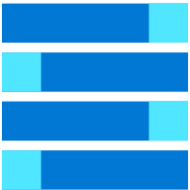

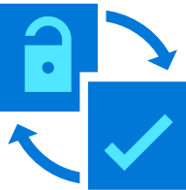

Any infrastructure, same tools
Azure Arc enabled Windows Servers
Bring on-premises and multi-cloud Windows Servers to Azure with Azure Arc
Reach
Management
Governance & security
Virtual machine
& bare-metal
Domain agnostic
  At-scale searchable inventory
  Unified management experience
  Consistent VM Extensions
Built-in Azure policies
Server security baseline
Role-based access control
Compliance across environments
Notes:
Talk track:
Azure takes a comprehensive approach and offers unique hybrid capabilities that give customers the flexibility to innovate anywhere in their environment.
Enabled by Azure Arc, you can bring Azure services to any existing infrastructure including other clouds you are using, so you can take advantage of cloud benefits everywhere, such as scalability, fast deployment, and always up-to-date cloud innovation.
You can build Azure-consistent new cloud infrastructure in your own datacenter with Azure Stack, so you can modernize your datacenter and run cloud native applications on-premises while taking advantage of existing investments and meeting regulatory compliances.
You can extend AI to edge devices with Azure IoT, so you can run machine learning and advanced analytics close to the users and the data. As a result, you can gain real-time insights and deliver immersive experiences at the edge of your network, opening up endless new business opportunities.
And you can do it all using Azure Arc as the single control plane to seamlessly manage and secure your IT resources, such as Linux/Windows VMs and Kubernetes clusters, across multicloud, on-premises and the edge.
Now let’s take a deeper look at the three hero Hybrid offerings: Azure Arc, Azure Stack and Azure IoT

Slide 14
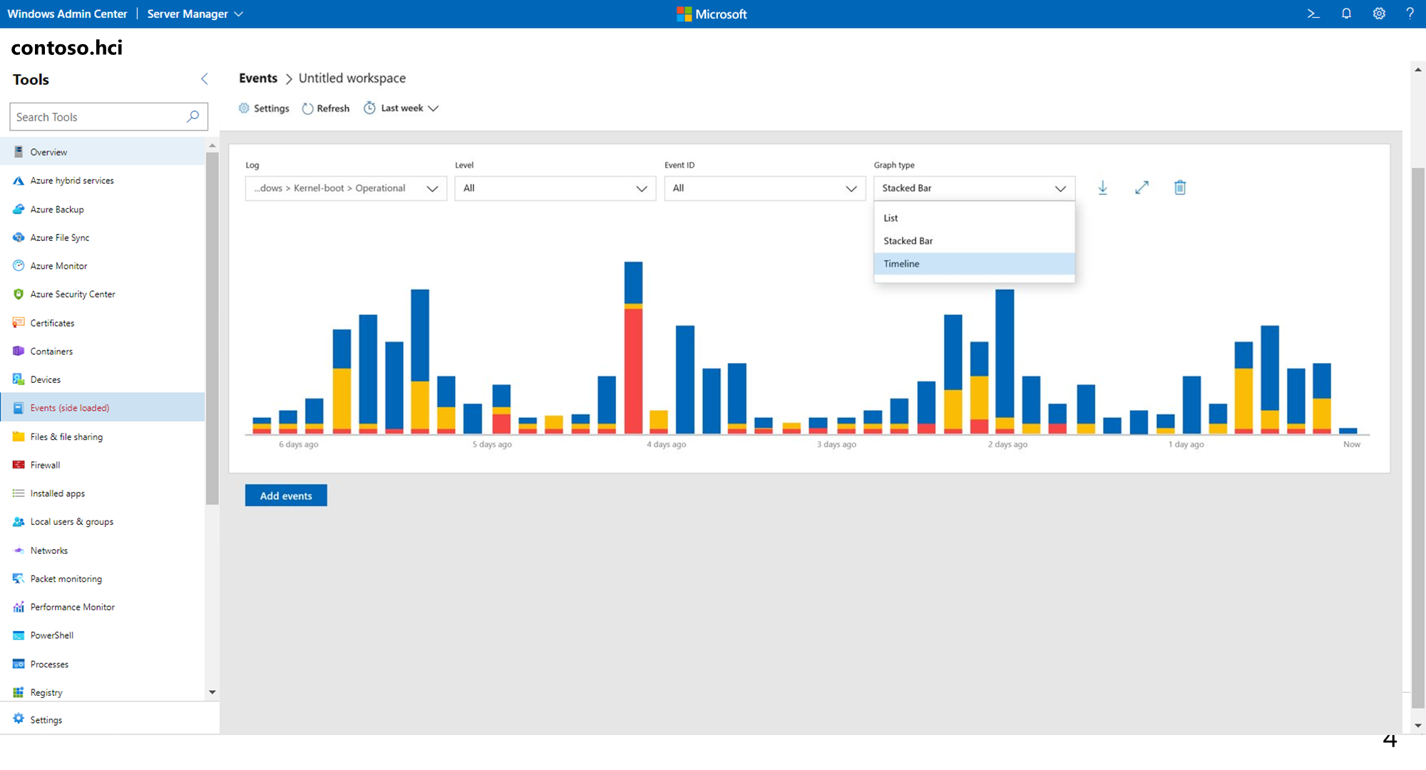
Manage Windows Server from anywhere with Windows Admin Center v2103
  Windows Admin Center v2103 is now generally available with the latest and greatest features for your server management experience
  Introducing…
  A new look to Event Viewer
  Improved virtual machine management with unique customization and seamless live migration support
  Automatic in-app updates that keeps your Windows Admin Center gateway and extensions always up-to-date
  Significant performance and accessibility improvements with an upgrade to HTTP/2
  Support for management over a web proxy
  And so much more!
Notes:
Windows Admin Center is a locally deployed, browser-based app for managing servers, clusters, hyper-converged infrastructure, and Windows 10 PCs. It comes at no additional cost beyond Windows and is ready to use in production.
It is Simple & lightweight, making management tasks a breeze. Install in under 5 minutes and manage servers in your environment immediately, no target configuration required. Integration with Azure services helps you leverage the power of the hybrid world. Manage Hyper-Converged clusters with powerful yet simple tools.

Slide 15
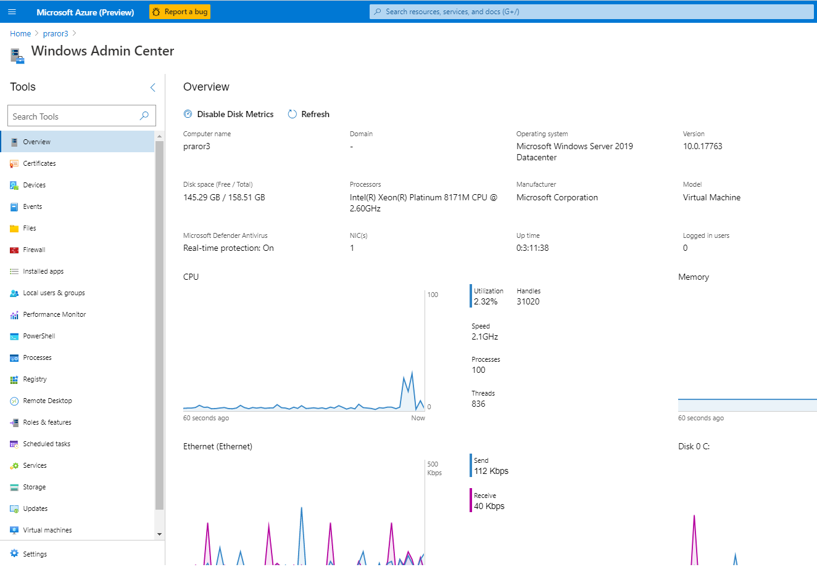
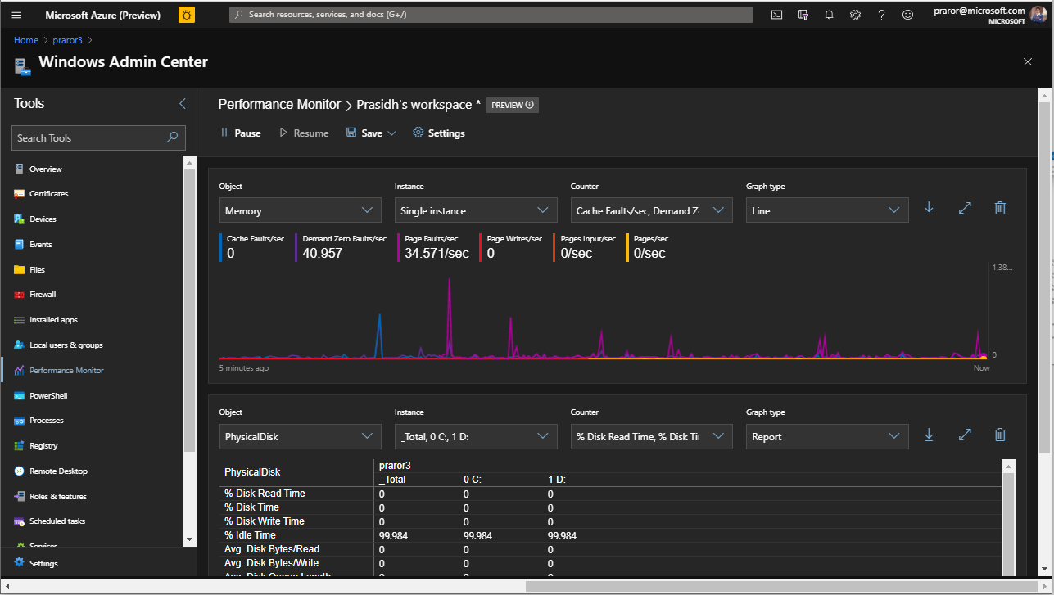
Windows Admin Center
Available in Public Preview Azure
Your favorite server management tool available natively in the Azure Portal​
  Included to manage your Azure VMs​
  Granular management, configuration, troubleshooting, and maintenance functionality​
  Support for VMs with Private IP addresses
  Integrated certificate experience
  Available for Windows Server 2016 and 2019 VMs​
  Always up to date with the newest features​

Slide 16
Storage Migration Service with Windows Server 2022
Azure
Migrate emulated file servers from NetApp FAS to Windows Server clusters
Enable Azure File Sync during migrations and SMS can migrate your data onto a modern Windows Server Virtual Machine on Azure
Storage Migration Service
file sync
file sync
file sync
HQ cluster
WS 2022
Branch
WS 2003 or
WS 2008/R2
Branch
Samba clusters
Notes:
Use Azure File Sync to centralize your organization's file shares in Azure Files, while keeping the flexibility, performance, and compatibility of an on-premises file server.
Azure File Sync transforms Windows Server into a quick cache of your Azure file share. You can use ANY protocol that's available on Windows Server to access your data locally, including SMB, NFS, and FTPS. You can have as many caches as you need across the world.

Slide 17









Azure Automanage
Simplify IT Operations for Windows Server VMs
Azure VM best practices
Backup
Security center
Exception only management
of Windows Server VMs
Ease of service discoverability once enrolled in Azure Automanage
Security patches applied without reboot to protect against critical security threats
Azure VM best practices
Log analytics
Monitoring
Automanage for
virtual machines
Configuration
management
Update
management
Change tracking
and inventory
Automation
account

Slide 18

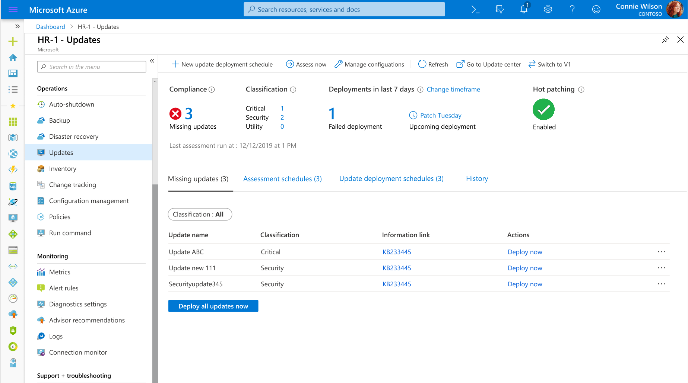
Azure Automanage for Windows Server
  Automatically apply security patches to new Windows Server VMs to protect against critical threat
  Maintain high-availability for apps
  and services running on Windows Server VMs while keeping your environment protected
  Automatic enrollment for ease
  of service discoverability

Slide 19
We need Dev and IT to work together
“How do I create
applications fast without worrying about the production environment?”
“How can I make
sure my new apps run
as expected on
production servers?”
“How do scale applications and maintain both a traditional and modern environment?”
Developers
IT
Notes:
Developers and IT teams sometimes have different perspectives about how app innovation works best.

Slide 20
Flexible application platform
Empower developers and IT pros with application platform to build and deploy diverse applications
Run business critical workloads such as SQL Server with 48TB of memory, and 2048 logical cores.
Improve container application deployment with smaller image size and simplified authentication.
Accelerate modernization of .NET applications with the new containerization tool in Windows Admin Center.
Scale containerized applications with Kubernetes using improvements in network policy implementation.

Slide 21
SQL Server: Better together with Windows Server 2022
64 sockets
2048
Isolated
apps
48 TB
logical
processors
Memory and highly-optimized for large memory systems
Support for massive scale-up systems
  Confidential computing with Intel Secured Guard Extension (SGX) on Intel Ice Lake

Slide 22

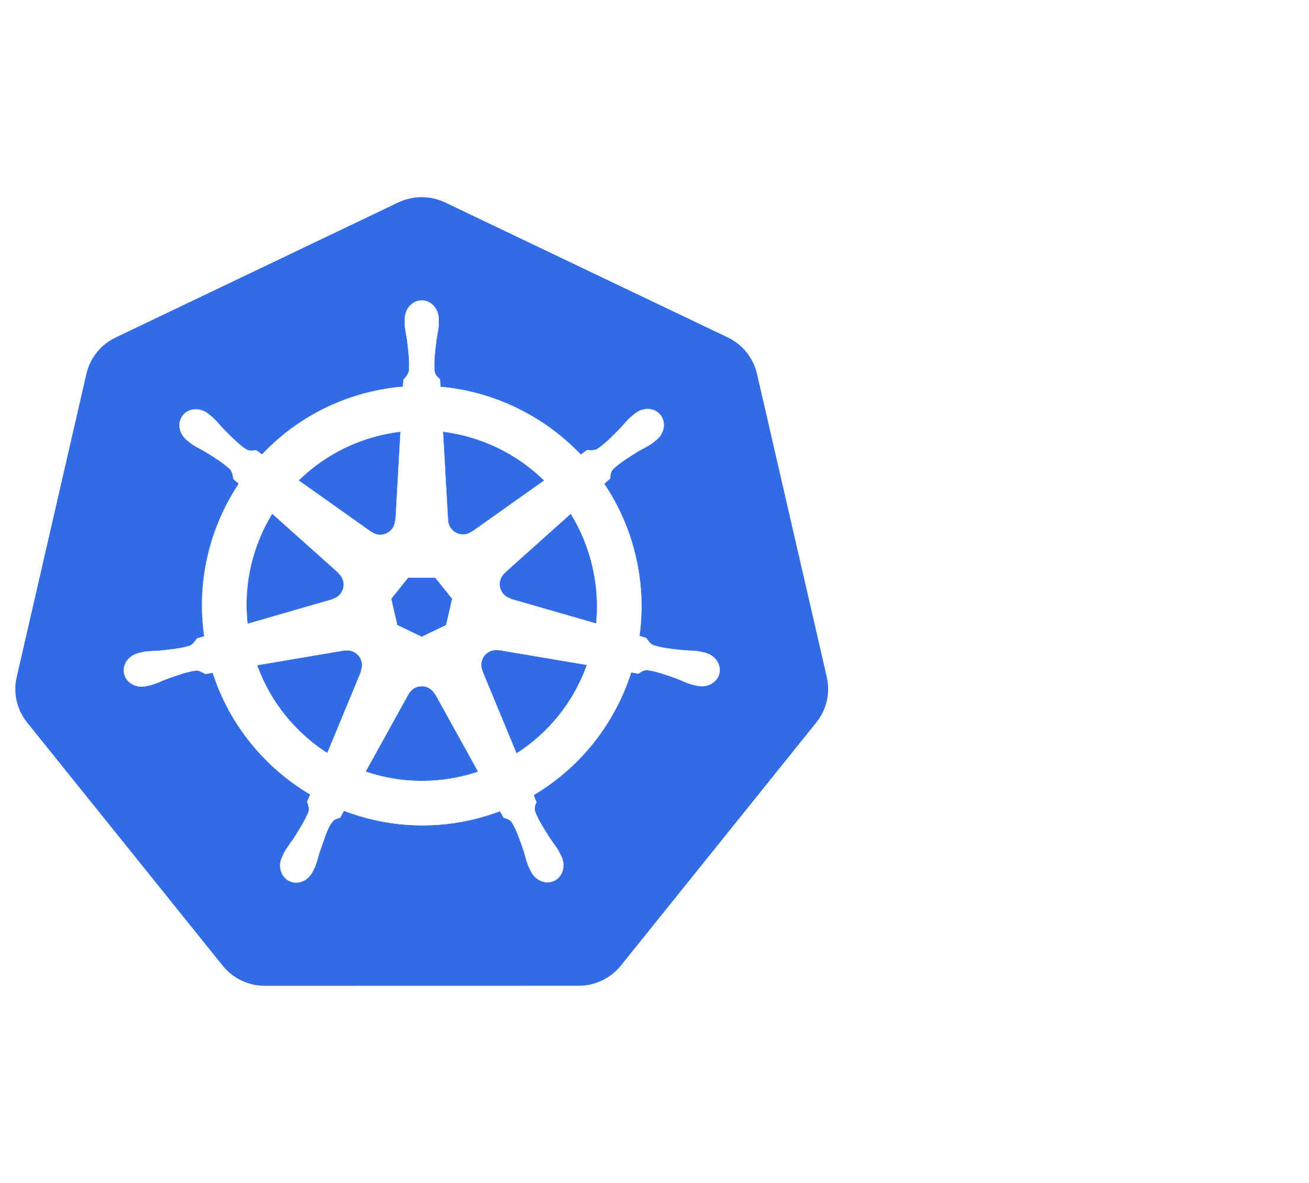
Accelerate app modernization with Windows containers
  Better Container Platform
  General container scalability and performance improvement
  Support for IPv6 and
  multiple subnets for flexibility
  in Kubernetes deployments
  Increased App compatibility
  Run globally-scalable applications
  with virtualized time zones in
  Windows containers
  gMSA v2 allows for Active Directory dependent applications on non-domain joined container hosts
  More Kubernetes Integration
  Alignment with industry standard containerd, bringing latest and greatest to Windows containers
  Enabling consistent network policy implementation across hybrid Kubernetes clusters

Slide 23
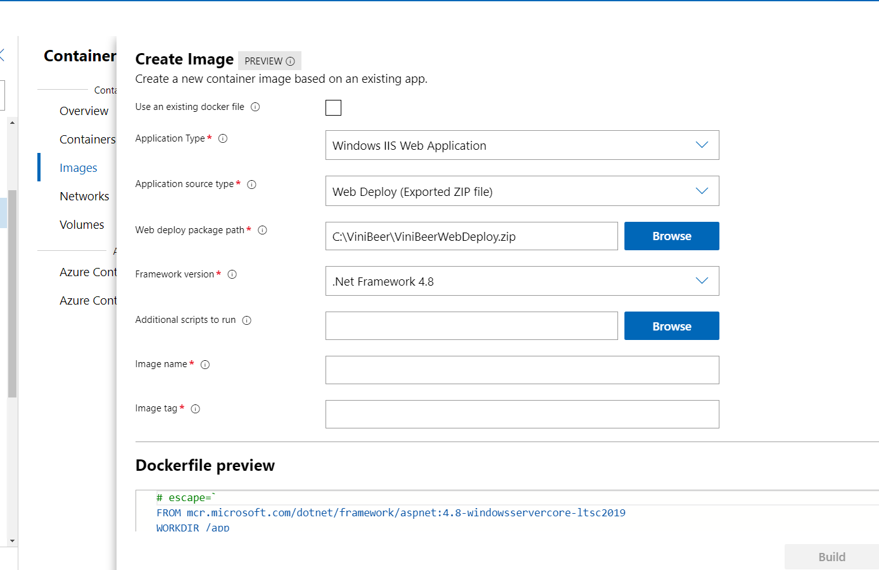
Improved tools for app modernization
Container tool in Windows Admin Center
Easily containerize applications with
an easy to use and friendly UI on
Windows Admin Center
Support for containerizing ASP.Net, Web Deploy, .Net, and MSI applications
Deploy containerized applications to AKS and AKS on Azure Stack HCI directly from Windows Admin Center
Skip the overhead of writing dockerfiles
and YAML files and let Windows Admin Center do that for you!

Slide 24
Get started
  Software Assurance customers have New Version Rights and can get Windows Server 2022 at no additional cost: Learn more
  Download Windows Server 2022 LTSC preview
  aka.ms/WS2022Preview
  Try Windows Server 2022 LTSC preview on Azure
  aka.ms/WS2022AzurePreview
  Download Windows Admin Center
  aka.ms/WindowsAdminCenter

